Slide 1
Cancer Free
Project: Health Guard

Slide 2

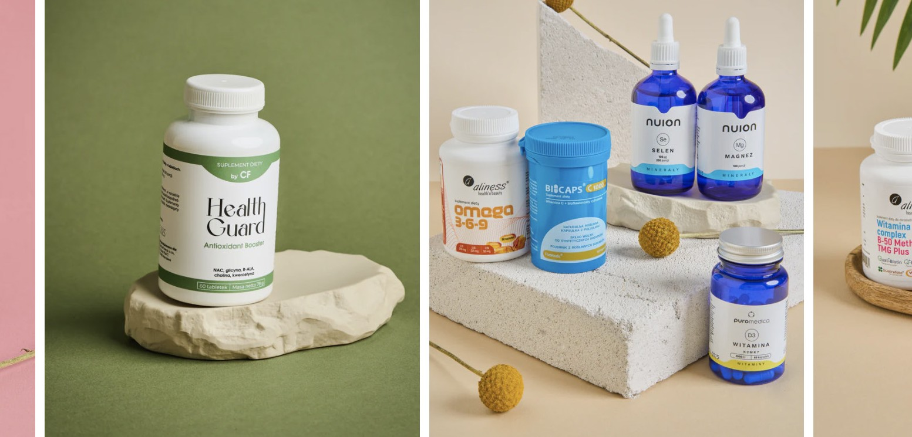


Our
Mission
The HealthGuard.pl project is an EDUCATIONAL and SALES platform.
Carefully selected products of the highest quality and a blog full of valuable articles written by practi- cing specialists from various ﬁelds of medicine.

Slide 3

Who?
For
For anyone who wants to practice oncological PREVENTION
Patients AFTER
oncological treatments

Slide 4
Prevention?
Why
As Hippocrates once said, "Prevention is better than cure!"
100 k
The number of annual deaths due to cancer
1,17 mln
The number of Poles living with cancer
440
The number of people diagnosed with cancer per 100k individuals
25%
Cancer is the cause of over 25% of deaths in Poland
"Over 90% of cases depend on external factors."

Slide 5
What is
Prevention?
High mortality rates due to cancer have led to an increased awareness and discussion of cancer in society. People are gradually becoming more conscious of the disease. However, oncological prevention is still a signiﬁcantly neglected topic, often confused with diagnosis.
PREVENTION IS ABOUT PREVENTING, NOT DIAGNOSING!
According to the guidelines of the National Institute of Public Health, prevention should be implemented in 4 phases, with the foundation being:
early prevention - establishing healthy lifestyle patterns
primary prevention (Phase I) - preventing diseases by controlling risk factors

Slide 6


Slide 7

Health Guard
What sets us apart?
We are the ﬁrst dietary supplement company in Poland to establish a scientiﬁc council (similar to a supervisory board).
Area of activity - a clear Niche in the Polish market: oncological prevention and support for the body.
We have a proprietary product consisting of 5 active substances, which are designed to detoxify the body and provide support for the nervous system, brain, heart, liver, and blood sugar regulation. Due to its properties, the product is dedicated to oncological prevention. The active substances used in the product have undergone numerous clinical studies conﬁrming their effectiveness in reducing the risk of developing cancer.
Sales are just one aspect of our operations - we place a strong emphasis on EDUCATION. That's why on our website and social media platforms, customers will ﬁnd articles, educational videos, graphics, and live sessions with doctors from various specialties. We believe in providing valuable educational content to empower our customers and promote awareness about health and prevention.

Slide 8
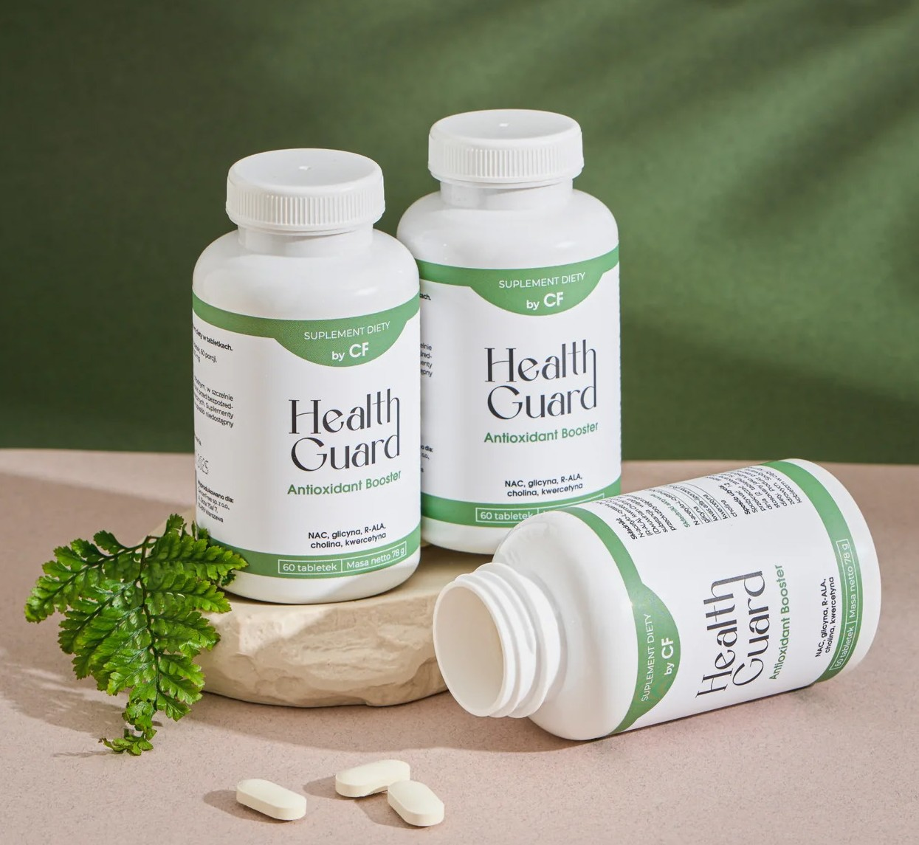
by CF
DIET SUPPLEMENT
A blend of powerful and safe antioxidants that not only help combat free radicals but also stimulate the regulation of other antioxidants in the human body through the regeneration of selected vitamins.
SUCH ACTION PROVIDES SUPPORT TO THE NATURAL DE- FENSE MECHANISMS OF THE BODY IN FIGHTING CARCINO- GENIC FACTORS THAT WE ENCOUNTER EVERY DAY!
Ingredients:
N-acetylcysteine (NAC), glycine, alpha-lipoic acid (R-ALA), quercetin (Quercetin Dihydrate 95%), choline (Choline Dihydrogen Citrate), bulking agent (cellulose), binding agent (calcium phosphates), anti-caking agent (silicon dioxide).
Składniki aktywne: 1 tabl. 2 tabl.
N-acetylcysteine (NAC) | 300 mg | 600 mg
Glycine | 200 mg | 400 mg
Alpha-lipoic acid (R-ALA) | 100 mg | 200 mg
Quercetin | 50 mg | 100 mg
choline | 50 mg | 100 mg
Usage instructions:
Take 1-2 tablets daily. Do not exceed the recom- mended daily dose (2 tablets). This dietary supple- ment should not be used as a substitute for a varied diet. The product is intended for healthy adults. It is not recommended for use by pregnant or breast- feeding women.

Slide 9


Health Guard
Attributes
The active substances used by us have a documented impact on:
IMMUINITY
by supporting glutathione synthesis and enhancing immune defense
INFLAMMATORY CONDITIONS
anti-inﬂammatory properties
HEART
beneﬁcial effect on the cardiovascular system and supports blood pressure regulation
BRAIN
Affects cognitive functions, improves concentration, learning, and memory

Slide 10

Health Guard
Attributes
The active substances used by us have a documented impact on:
LIVER
Supports liver function by enhancing natural detoxiﬁcation processes, dige- stion, and providing protective effects on liver cells to aid in combating environmental pollutants
NERVOUS SYSTEM
egulates the functioning of the nervous system, which can help reduce anxiety and counteract de- pression, ultimately promoting a sense of calmness and reducing sensory irritability
BLOOD SUGAR REGULATION
Helps maintain a normal glucose level and increases tissue sensitivity to insulin

Slide 12
Business
Areas of operation
1
RETAIL SALES IN AN ONLINE STORE
2
B2B WITH PHARMACIES AND STORES
3
COOPERATION WITH EMPLOYERS TO MEET ESG REQUIREMENTS

Slide 13
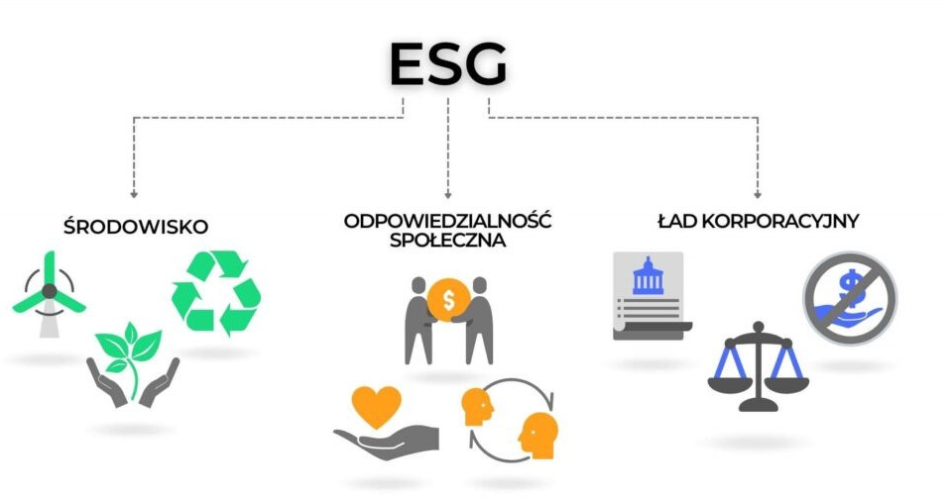
Health Guard and ESG
Requirements
Assistance in meeting social responsibility requirements.
ENVIRONMENTAL
SOCIAL
GOVERNANCE

Slide 14


Corporate
Bonuses
What are companies currently doing to improve the well-being of their employees?
MEDICAL PACKAGES
Access to diagnostics and treatment
SPORTS PACKAGES
Taking care of physical health
LANGUAGE COURSES
Individual development care
ENTERTAINMENT
Taking care of rest in the workplace

Slide 15

??
But what about
Prevention?
Employers are doing a lot, but they are missing
the most important action: HEALTH PREVEN- TION for employees (regular check-ups are diagnostics - often mistaken for prevention).
?

Slide 16

Health Guard offer for
Employer
In order to signiﬁcantly improve the well-being of your employees.
SUBSCRIPTION
Subscription to Health Guard supplement by CF for every employee in the company
MONTHLY DELIVERY
The product will be delivered to employees regularly, every 30 days
NEWSLETTER
Every month, employees will receive a newsletter via email, which will provide them with tips on how to improve their health in the four key pillars (DIET, PHYSICAL ACTIVITY, SLEEP, EMOTIONS)
TRAINING
Before starting the supplemen- tation, we offer an onboarding training for all employees where we explain the beneﬁts of using our supplement and address any questions they may have.

Slide 17




Employer
Benefits for
Areas inﬂuenced by Health Guard supplement.
!
CONCENTRATION
Improvement in concentra- tion, stimulation of memory processes, and learning
STRESS
Reduction of tension, feelings of stress, and irritability
PAIN
Reducing inﬂammation, often associated with pain, fatigue, and irritation
WELL-BEING
Improved well-being of individu- als leads to increased productivi- ty in work and enhances the overall quality of the atmosphere within the team.

Slide 18
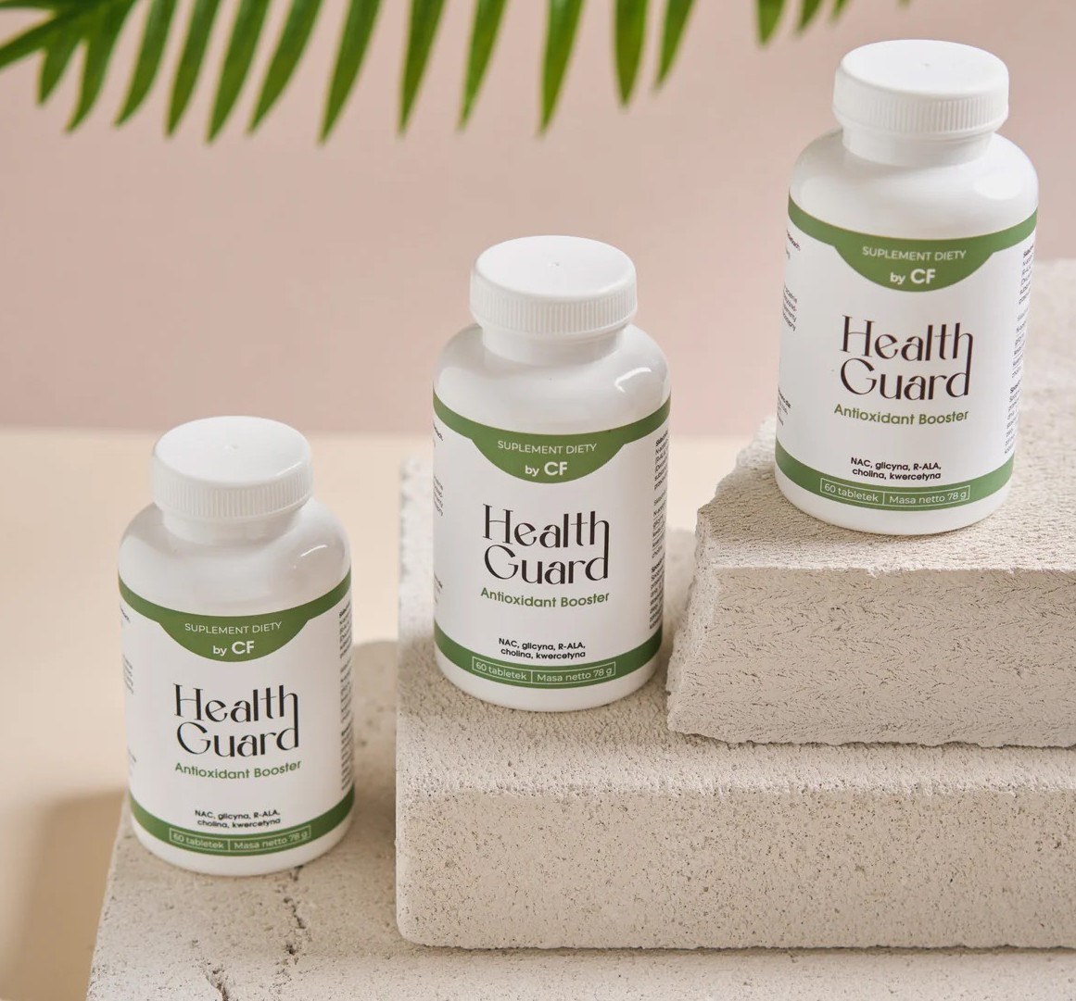
Does it
Work?
There are over 100 different stdies conﬁrming the effectiveness of the substances contained in HEALTH GUARD!

Slide 19

Sekhar R.V. GlyNAC Supplementation improves glutathione deﬁciency, oxidative stress, mitochondrial dysfunction,
inﬂammation, aging hallmarks, metabolic defects, muscle strength, cognitive decline, and body composition: Im- plications for healthy aging. J. Nutr. 2021;151:3606–3616. doi: 10.1093/jn/nxab309.
Wu G., Fang Y.Z., Yang S., Lupton J.R., Turner N.D. Glutathione metabolism and its implications for health. J. Nutr.
2004;134:489–492. doi: 10.1093/jn/134.3.489.
Kumar P., Osahon O., Vides D.B., Hanania N., Minard C.G., Sekhar R.V. Severe glutathione deﬁciency, oxidative stress and oxidant damage in adults hospitalized with COVID-19: Implications for GlyNAC (Glycine and N-Acetylcysteine) supplementation. Antioxidants. 2021;11:50. doi: 10.3390/antiox11010050.
Kumar P., Liu C., Hsu J.W., Chacko S., Minard C., Jahoor F., Sekhar R.V. Glycine and N-acetylcysteine (GlyNAC) sup- plementation in older adults improves glutathione deﬁciency, oxidative stress, mitochondrial dysfunction, inﬂam- mation, insulin resistance, endothelial dysfunction, genotoxicity, muscle strength, and cognition: Results of a pilot clinical trial. Clin. Transl Med. 2021;11:e372. doi: 10.1002/ctm2.372.
Cieslik K.A., Sekhar R.V., Granillo A., Reddy A., Medrano G., Heredia C.P., Entman M.L., Hamilton D.J., Li S., Reineke E., et al. Improved cardiovascular function in old mice after N-Acetyl cysteine and glycine supplemented diet: Inﬂam-
Here are just a few articles and scientiﬁc papers containing reviews of medical research on the following substances: NAC + Gly
mation and mitochondrial factors. J. Gerontol. A Biol. Sci. Med. Sci. 2018;73:1167–1177. doi: 10.1093/gerona/gly034.
6. Kumar P., Liu C., Suliburk J.W., Minard C.G., Muthupillai R., Chacko S., Hsu J.W., Jahoor F., Sekhar R.V. Supplemen-
ting Glycine and N-acetylcysteine (GlyNAC) in Aging HIV patients improves oxidative stress, mitochondrial dys-
function, inﬂammation, endothelial dysfunction, insulin resistance, genotoxicity, strength, and cognition: Results of
an open-label clinical trial. Biomedicines. 2020;8:390. doi: 10.3390/biomedicines8100390.

Slide 20
De Flora S, et al. Eur Respir J J. 1997 Jul;10(7):1535-41.
Akiba S, et al., Assay of protein-bound lipoic acid in tissues by a new enzymatic method. Anal Biochem., 1998
Wollin S.D., Jones P.J., Alpha-lipoic acid and cardiovascular disease. J Nutr., 2003
Moini H, Packer L, Saris N.E., Antioxidant and prooxidant activities of alpha-lipoic acid and dihydrolipoic acid. Toxi- col Appl Pharmacol., 2002
Merry BJ, Kirk AJ, Goyns MH. Dietary lipoic acid supplementation can mimic or block the effect of dietary restric- tion on life span. Mech Ageing Dev., 2008
Satoh S, et al., Selective and sensitive determination of lipoyllysine (protein-bound alpha-lipoic acid) in biological specimens by high-performance liquid chromatography with ﬂuorescence detection. Anal Chim Acta., 2008
Hiltunen JK, et al. Mitochondrial fatty acid synthesis type II: more than just fatty acids. J Biol Chem., 2009
Shay KP, et al. Alpha-lipoic acid as a dietary supplement: molecular mechanisms and therapeutic potential. Bio- chim Biophys Acta., 2009
Here are just a few articles and scientiﬁc papers containing reviews of medical research on the following substances:
R-ALA

Slide 21
Mehedint MG, Zeisel SH., Choline’s role in maintaining liver function: new evidence for epigenetic mechanisms, Curr Opin Clin
Nutr Metab Care, 2013
Ross RG, Hunter SK, McCarthy L, Beuler J, Hutchison AK, Wagner BD, Leonard S, Stevens KE, Freedman R., Perinatal choline effects on neonatal pathophysiology related to later schizophrenia risk, Am J Psychiatry, 2013
Tayebati SK, Amenta F., Choline-containing phospholipids: relevance to brain functional pathways, Clin Chem Lab Med, 2013
Blusztajn JK, Mellott TJ., Neuroprotective actions of perinatal choline nutrition, Clin Chem Lab Med., 2013
Corbin KD, Zeisel SH.,The nutrigenetics and nutrigenomics of the dietary requirement for choline, Prog Mol Biol Transl Sci, 2012
Blusztajn JK, Mellott TJ., Choline nutrition programs brain development via DNA and histone methylation. Cent Nerv Syst Agents Med Chem., 2012
Hollenbeck CB., An introduction to the nutrition and metabolism of choline, Cent Nerv Syst Agents Med Chem., 2012D’Andrea, G. (2015). Quercetin: a ﬂavonol with multifaceted therapeutic applications?. Fitoterapia, 106, 256-271.
Kobylińska, A., & Janas, K. M. (2015). Prozdrowotna rola kwercetyny obecnej w diecie człowieka. Advances in Hygiene & Experi- mental Medicine/Postepy Higieny i Medycyny Doswiadczalnej, 69.
Li, Y., Yao, J., Han, C., Yang, J., Chaudhry, M., Wang, S., … & Yin, Y. (2016). Quercetin, inﬂammation and immunity. Nutrients, 8(3), 167.
Gramza-Michałowska, A., Bueschke, M., & Kulczyński, B. (2019). ZNACZENIE KWERCETYNY JAKO ZWIĄZKU WSPOMAGAJĄCE- GO WYDOLNOŚĆ W DIECIE SPORTOWCA. Kosmos, 68(1), 145-151.
Here are just a few articles and scientiﬁc papers containing reviews of medical research on the following substances: Quercetin
Choline
11. Costa, L. G., Garrick, J. M., Roquè, P. J., & Pellacani, C. (2016). Mechanisms of neuroprotection by quercetin: counteracting oxidative
stress and more. Oxidative medicine and cellular longevity, 2016.
12.Patel, R. V., Mistry, B. M., Shinde, S. K., Syed, R., Singh, V., & Shin, H. S. (2018). Therapeutic potential of quercetin as a cardiovascular
agent. European journal of medicinal chemistry, 155, 889-904.
13.Nabavi, S. F., Russo, G. L., Daglia, M., & Nabavi, S. M. (2015). Role of quercetin as an alternative for obesity treatment: you are what
you eat!. Food chemistry, 179, 305-310.

